Slide 1
Welcome to the DC UserCon

Slide 2
Air-Gapped VCF Considerations for Disconnected Networks

Slide 3




Justin P. Sider
Chief Information Officer – Belay Technologies
https://belaytech.com
Personal Blog
https://invoke-automation.blog
GitHub
https://github.com/jpsider
Twitter (X)/Slack
jpsider
VMware Community
vExpert, VMUG Co-Leader, Code Coach, VMUG BOD

Slide 4
Agenda
What does Air-Gapped Mean?
12 Primary Considerations
Recommended Workflow
Common Pitfalls
Quick Checklist
Conclusion

Slide 5
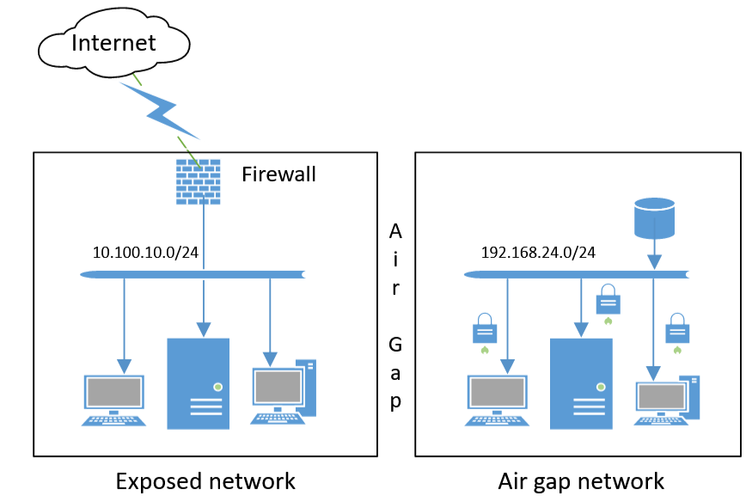
What does Air-Gapped Mean?
No Internet
Physically isolated
Used for High-Security Environments
Government or Military
Financial or Healthcare
Industrial Control Systems
Critical infrastructure
Video/Security systems
This is not a DMZ!

Slide 6
12 Considerations

Slide 7
1. Product & Lifecycle Management
Collect all required bundles: ESXi, vCenter, NSX, vSAN, HCX, SDDC Manager, optional add-ons.
Validate compatibility using VCF 9 BOM and Interoperability Matrix.
Hardware Compatibility Guide (errr HCL)
Use Offline Depot in Lifecycle Manager for air-gapped updates.
Stage bundles for repeatable patching and rollbacks.
Document component dependencies.

Slide 8
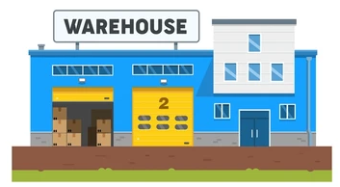

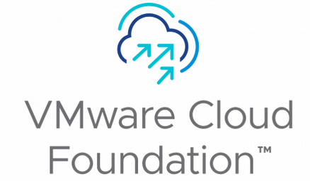
2. Internal Repositories and Distribution
Use VCF Download Tool (VCFDT) in connected environment to pull all artifacts.
Host bundles on internal HTTP/HTTPS repo for SDDC Manager & LCM.
Use vCenter Content Library for ISOs/OVAs.
Verify checksums and signed manifests.
Version-control repositories for compliance and audit.

Slide 9


3. Secure Transfer and Storage

Slide 10
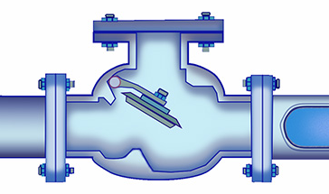

3. Secure Transfer and Storage
Transfer via controlled removable media or staging workstation.
Sneaker-Net
Diode
Cross Domain Solution
Verify integrity using checksums before and after import.
Maintain approval workflow and audit logs.
Store artifacts in write-once or versioned storage.
Secure physical media according to organizational policies.

Slide 11

4. Registration, Licensing, and Entitlements
VCF 9 unified license file covers all components.
Disconnected mode: export usage file -> upload externally -> download license file -> import offline.
Evaluation period extended to 90 days.
Maintain internal documentation of license allocations.
Confirm license files before deployment.
Set calendar reminders for license expiration
Start the renewal process EARLY!

Slide 12

5. Networking Basics
Internal DNS with forward/reverse lookup for SSO and component registration.
Internal NTP server to prevent certificate and SSO failures.
Segregated networks: Management, vMotion, vSAN, NSX Overlay.
Firewall rules between components (only required ports).
Document network design in air-gapped environment.
Wiki, Confluence, Sharepoint

Slide 13

6. Certificates and PKI
Decide: enterprise CA or self-signed certificates.
SDDC Manager requires supported formats (PEM, PKCS12).
Plan certificate lifecycle offline (renewal, replacement).
Intermediate CA vs. Root CA
Test certificate replacement in staging domain first.
Maintain certificate inventory and expiration tracking.

Slide 14

7. Support & Troubleshooting
Do you have a TAM?
Do you have a Support Contract?
Plan offline support bundle collection and export.
VMware support cannot connect directly in air-gapped environments.
Document who, how, and where support bundles are handed over.
Talk to your security team!
Maintain escalation steps for critical incidents.

Slide 15

8. Monitoring, Logging, and Backup
Centralize logs in local syslog/SIEM.
Configure backups for vCenter, NSX, SDDC Manager.
Test restore workflows regularly inside the air-gapped environment.
Deploy monitoring (vROps) offline; configure alerting locally.
Email?
Chat/IRC?
Desktop Notifications?
Maintain audit trails for compliance.

Slide 16

9. Security and Compliance
Enforce RBAC and least privilege access.
Follow VMware & CIS hardening guides.
Enforce firmware/driver compliance.
Audit administrative actions; integrate logs into SIEM.
Conduct periodic compliance checks.

Slide 17



10. Automation & Infrastructure as Code
Use Terraform, Ansible, PowerCLI scripts for standardized deployments.
Validate workflows in staging before production.
Automate compliance verification and drift detection.
Maintain versioned scripts and documentation.
Host scripts & configuration files in an internal Git repository.

Slide 18
11. Upgrade and Patching Process
Stage updates in test domains first.
Use offline depot for Lifecycle Manager updates.
Validate firmware/driver compatibility per HCL.
Plan coordinated fleet upgrades across workload domains.
Maintain rollback plans and snapshots before upgrades.

Slide 19
12. Third-Party & AI Integrations
Offline installers for backup, monitoring, AV.
Private AI Foundation with NVIDIA supported in air-gapped environment.
Maintain internal NGC/mirror repositories for container images and ML models.
Confirm vendor SLAs support disconnected deployments.
Include AI workload validation in test domain.
Vali Cyber

Slide 20
Tools We’ve implemented
FTP Server
Harbor
PowerShell Gallery
Linux Repositories
Windows Server Update Servers
Documentation, Documentation, Documentation!

Slide 21
Recommended workflow
Plan: BOM, hardware, firmware baseline.
Download artifacts using VCFDT in connected site.
Secure transfer to air-gapped environment.
Populate offline depot and content library.
Deploy management domain.
Validate VM lifecycle, vMotion, vSAN policies.
Stage patch/upgrade workflow using offline depot.
Document all steps for repeatability.

Slide 22
Common Pitfalls
Missing bundles halts deployment.
DNS/NTP misconfig causes SSO/cert failures.
Firmware mismatch blocks ESXi upgrade.
Incorrect support assumptions; no remote access.
Skipping checksum validation leads to corrupted/malicious artifacts.
Unverified third-party components can break workflow.

Slide 23
Quick Checklist
Select VCF 9 version & gather artifacts.
Confirm HCL compliance (hardware & firmware).
Set up Offline Depot with VCFDT.
Configure DNS, NTP, PKI before deployment.
Deploy SDDC Manager & management domain.
Enable logging, monitoring, and backups.
Document secure transfer workflow.
Test upgrades in staging first.
Validate third-party agents and AI repositories.

Slide 24
Conclusion
Tie your Sneakers!

Slide 26







Elements

